Slide 1

ALGEBRA
Math 10-3

Slide 2
LESSON 2
POLYNOMIALS

Slide 3
ALGEBRAIC EXPRESSIONS

Slide 4
ALGEBRAIC EXPRESSIONS
Mathematical statements use two types of quantities: constants and variables.
A constant is a symbol whose value does not change .
Examples: 26, -6, 2.71828,
A variable is a symbol that takes on different values.
Examples: a, b, c,… x, y, z

Slide 5
ALGEBRAIC EXPRESSIONS
An algebraic expression is the result of associating constants and variables by addition, subtraction, multiplication, division, including roots and powers.
EXAMPLE

Slide 6
ALGEBRAIC EXPRESSIONS
In the expression 2xy each of the factors 2 , x and y can be considered as a coefficient of the other, where 2 is called the numerical coefficient of x y and xy is the literal coefficient of 2.
The expression consisting of a product of constants and variables including the (+) or (–) sign preceding it is called an algebraic term or simply a term.
ALGEBRAIC EXPRESSION | NUMBER OF TERMS | TERMS
 | 1
 | 2
 | 3

Slide 7
EVALUATION OF ALGEBRAIC EXPRESSIONS
An algebraic expression can be evaluated by substituting the values of the variable involved and then performing the operations.
EXAMPLE
Evaluate each of the following algebraic expressions for a = -1, b = 2, x = -2 and y = 3.

Slide 8
INTEGER AND ZERO EXPONENTS

Slide 9
EXPONENTIAL EXPRESSIONS
If b is any real number and n is a natural number, then
b is a factor n times
b^{n}= b  b  b  . . .  b
where b is the base and n is the exponent.

Slide 10
EXPONENTIAL EXPRESSIONS
EXAMPLE
–5⁴ = –(5  5  5  5) = –625
(–5)⁴ = (–5)(–5)(–5)(–5) = 625
Pay close attention to the difference between –5⁴ (the base is 5) and (–5)⁴ (the base is –5).

Slide 11
EXPONENTIAL EXPRESSIONS
Evaluate.
a. (–3⁴)(–4)²
b.
Solution:
a. (–3⁴)(–4)² = –(3  3  3  3)  (–4)(–4)
= –81  16

Slide 12
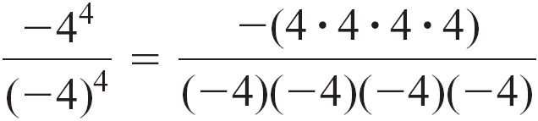
EXPONENTIAL EXPRESSIONS
cont’d
b.

Slide 13
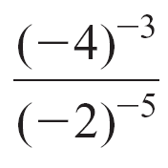
EVALUATE AN EXPONENTIAL EXPRESSION
Evaluate.
a. (–2⁴)(–3)² b. c. –π ⁰
Solution:
a. (–2⁴)(–3)² = –(2  2  2  2)(–3)(–3)
= –(16)(9)
= –144

Slide 14
EVALUATE AN EXPONENTIAL EXPRESSION
cont’d
b .
c. –π ⁰ = –(π ⁰)
= –1

Slide 15
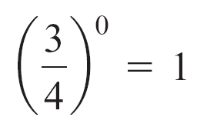
EXPONENTIAL EXPRESSIONS
We can extend the definition of exponent to all integers. We begin with the case of zero as an exponent.
Definition of b⁰
For any nonzero real number b, b⁰ = 1.
EXAMPLE
3⁰ = 1 –7⁰ = –1 (a² + 1)⁰ = 1

Slide 16
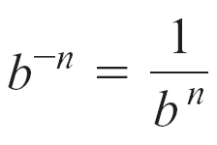
EXPONENTIAL EXPRESSIONS
Now we extend the definition to include negative integers.
Definition of b^{–n}
If b ≠ 0 and n is a natural number, then and
EXAMPLE

Slide 17
LAWS OF EXPONENTS
Let and The following laws of exponents hold.

Slide 18
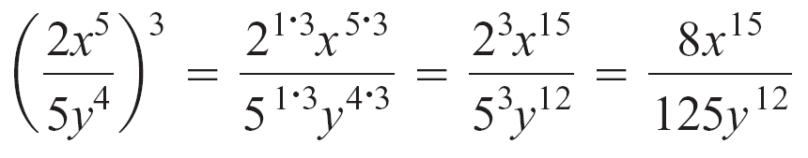
LAWS OF EXPONENTS
EXAMPLE
a⁴  a  a³ = a⁴ ⁺ ¹ ⁺ ³ = a⁸
(x⁴y³)(xy⁵z²) = x⁴ ⁺ ¹y³ ⁺ ⁵z² = x⁵y⁸z²
= a^{7 – 2}b^{1 – 5} = a⁵b^{– 4} =
(uv³)⁵ = u^{1  5}v^{3  5} = u ⁵v¹⁵
Add the exponents of the like bases. Recall that a = a¹.
Add the exponents of the
like bases.
Subtract the exponents of
the like bases.
Multiply the exponents.
Multiply the exponents.

Slide 19
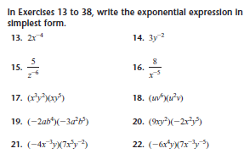
LAWS OF EXPONENTS

Slide 20
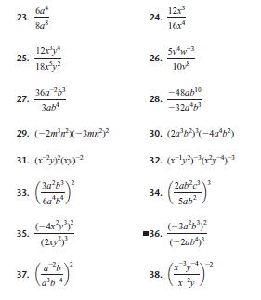

Slide 21
CLASSIFICATION OF POLYNOMIALS

Slide 22
CLASSIFICATION OF POLYNOMIALS
An algebraic expression may be classified as a polynomial, a rational expression or an irrational expression.
A polynomial is an algebraic expression of one or more terms each of which is a product of constants and variables, where each variable is raised to a positive integral exponent including zero.
The following are examples of polynomials

Slide 23
CLASSIFICATION OF POLYNOMIALS
Polynomials may be classified according to degree, according to the
number of terms present, or according to the nature of the numerical
coefficient.
When polynomials are classified according to the number of terms it
has, the polynomial may be described as:
monomial – a polynomial of one term
binomial - a polynomial of two terms
trinomial – a polynomial of three terms
multinomial or simply polynomial – polynomial of four or more terms

Slide 24
CLASSIFICATION OF POLYNOMIALS
EXAMPLE
Polynomial | Number of Terms | Name of Function
 | 1 | monomial
 | 2 | binomial
 | 3 | trinomial
 | 5 | multinomial or polynomial
 | 2 | binomial
 | 4 | multinomial or polynomial

Slide 25
CLASSIFICATION OF POLYNOMIALS
The degree of a monomial is the sum of the exponents of its literal
coefficients.
The degree of a polynomial is the highest degree of its monomial terms.
Polynomials are classified according to degree as:
zero degree
1st degree or linear
2nd degree or quadratic
3rd degree or cubic
4th degree or quartic
nth degree , for any n a positive integer

Slide 26
EXAMPLE
Polynomial | Degree | Name of Function
 | 1 | linear
 | 2 | quadratic
 | 4 | quartic
 | 6 | 6th degree
 | 14 | 14th degree
 | 0 | zero degree or constant
 | 5
 | 7

Slide 27
Polynomials can also be classified according to the nature of its numerical coefficient as being integral, rational or irrational.
CLASSIFICATION OF POLYNOMIALS
TYPE | DESCRIPTION
Integral | has integers as numerical coefficients of all of the terms
Rational | when some of the numerical coefficients are expressed as a ratio of two integers or as a fraction or as decimal numbers
Irrational | when some of the coefficients of the terms are irrational

Slide 28
EXAMPLE
Polynomial | Nature of Numerical Coefficient | Name of Function
 | all integers | integral
 | all integers | integral
 | one is irrational | irrational
 | one is irrational | irrational
 | two are ratio of two integers | rational

Slide 29
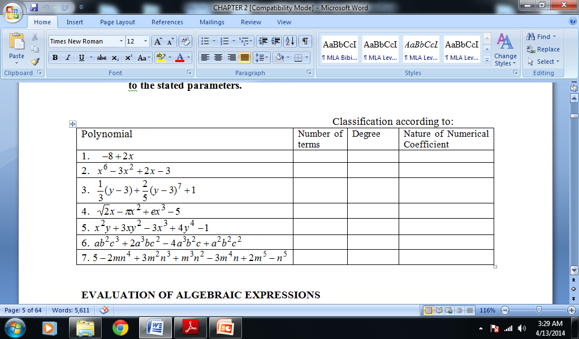
CLASSIFICATION OF POLYNOMIALS
Complete the table below by classifying each of the given polynomials
according to the stated parameters.

Slide 30
STANDARD FORM OF A POLYNOMIAL
Definition of the Standard Form of a Polynomial
The standard form of a polynomial of degree n in the variable x is
a_{n}x^{n} + a_{n – 1}x^{n – 1} + … + a₂x² + a₁x + a₀
where a_{n} ≠ 0 and n is a nonnegative integer.
The coefficient a_{n} is the leading coefficient, and a₀ is the constant term.
A polynomial is in standard form when the terms are written in decreasing powers of the variable.

Slide 31
EXAMPLE
STANDARD FORM OF A POLYNOMIAL

Slide 32
A rational expression is an algebraic expression involving a ratio of two polynomials.
EXAMPLE
An irrational expression is an algebraic expression that involves
variables raised to fractional exponents, such as the following:
EXAMPLE

Slide 33
OPERATIONS ON POLYNOMIALS

Slide 34
ADDITION AND SUBTRACTION
Like real numbers, we can also perform operations on algebraic expressions, in particular on polynomials. We begin by removal of grouping symbols and then addition and subtraction.
When simplifying polynomials involving grouping symbols, we begin by removing them. The commonly used grouping symbols are {braces}, [brackets], and (parentheses).
Rules in Simplifying Polynomials Involving Grouping Symbols
Remove the grouping symbols by applying the distributive property of multiplication over addition.
Remove the innermost symbols first and work from the inside out.
Collect similar terms as they appear.
Arrange the resulting polynomial in alphabetical and descending order of one variable.

Slide 35
ADDITION AND SUBTRACTION
Simplify the given expression by removing symbols of grouping:
6.

Slide 36
ADDITION AND SUBTRACTION
To add/subtract polynomials, arrange similar terms in column and find the sum/difference in each column.

Slide 37
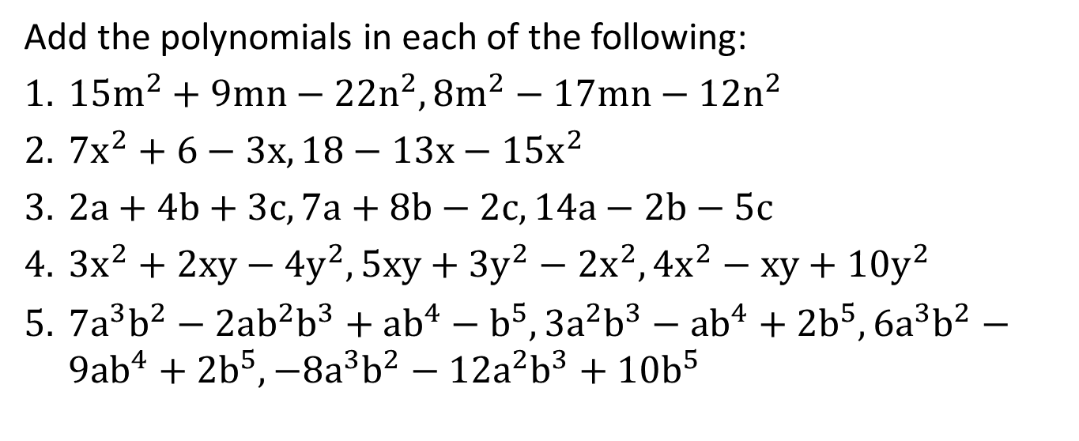
ADDITION AND SUBTRACTION
Add the polynomials in each of the following:
$15m^{2}+9mn−22n^{2}, 8m^{2}−17mn−12n^{2}$
$7x^{2}+6−3x, 18−13x−15x^{2}$
$2a+4b+3c, 7a+8b−2c, 14a−2b−5c$
$3x^{2}+2xy−4y^{2}, 5xy+3y^{2}−2x^{2}, 4x^{2}−xy+10y^{2}$
$7a^{3}b^{2}−2ab^{2}b^{3}+ab^{4}−b^{5}, 3a^{2}b^{3}−ab^{4}+2b^{5}, 6a^{3}b^{2}−9ab^{4}+2b^{5}, −8a^{3}b^{2}−12a^{2}b^{3}+10b^{5}$

Slide 38
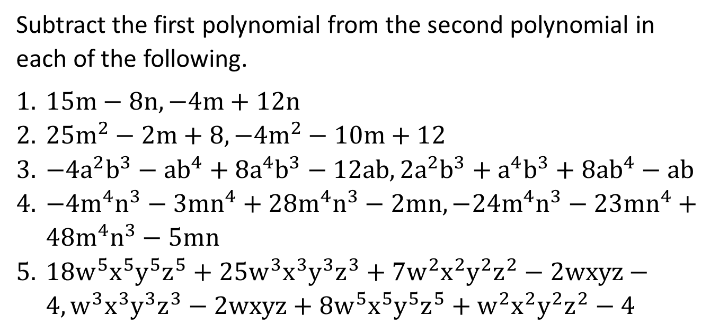
ADDITION AND SUBTRACTION
Subtract the first polynomial from the second polynomial in each of the following.
$15m−8n, −4m+12n$
$25m^{2}−2m+8, −4m^{2}−10m+12$
$−4a^{2}b^{3}−ab^{4}+8a^{4}b^{3}−12ab, 2a^{2}b^{3}+a^{4}b^{3}+8ab^{4}−ab$
$−4m^{4}n^{3}−3mn^{4}+28m^{4}n^{3}−2mn, −24m^{4}n^{3}−23mn^{4}+48m^{4}n^{3}−5mn$
$18w^{5}x^{5}y^{5}z^{5}+25w^{3}x^{3}y^{3}z^{3}+7w^{2}x^{2}y^{2}z^{2}−2wxyz−4, w^{3}x^{3}y^{3}z^{3}−2wxyz+8w^{5}x^{5}y^{5}z^{5}+w^{2}x^{2}y^{2}z^{2}−4$

Slide 39
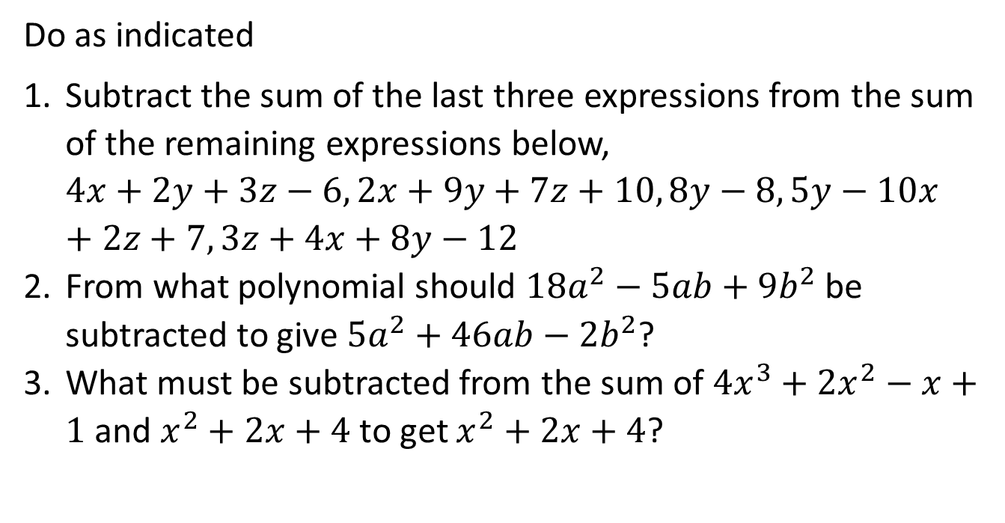
ADDITION AND SUBTRACTION
Do as indicated
Subtract the sum of the last three expressions from the sum of the remaining expressions below, $4x+2y+3z−6, 2x+9y+7z+10, 8y−8, 5y−10x+2z+7, 3z+4x+8y−12$
From what polynomial should $18a^{2}−5ab+9b^{2}$ be subtracted to give $5a^{2}+46ab−2b^{2}$?
What must be subtracted from the sum of $4x^{3}+2x^{2}−x+1$ and $x^{2}+2x+4$ to get $x^{2}+2x+4$?

Slide 40
MULTIPLICATION OF POLYNOMIALS
The distributive property is used to multiply polynomials. Arrange the terms of both polynomials in descending powers of one variable, then multiply each term of one polynomial by all the terms of the other polynomial. Combine similar terms and express the resulting expression in alphabetical and descending order in one variable.
Another way of multiplying polynomial arranged in descending power is to use an array. The coefficients of the first polynomial are written from left to right as the headings of the columns and the coefficients of the second polynomial are written from top to bottom as the heading of the row. Next fill in the intersections of the row and column with the products of the column headings and row headings. Add diagonally these products. The sum will be the coefficients of the product.

Slide 41
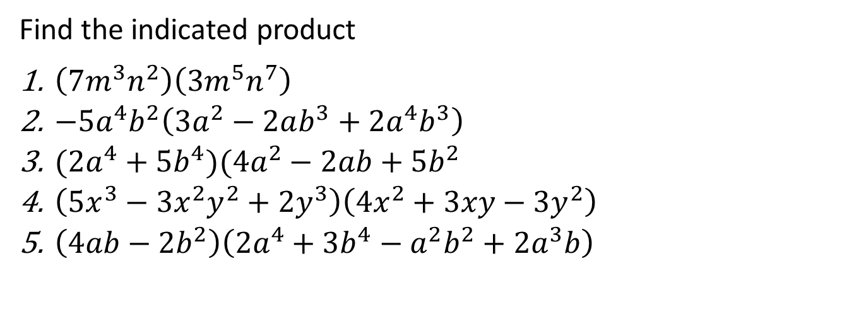
MULTIPLICATION OF POLYNOMIALS
Find the indicated product
$\left(7m^{3}n^{2}\right)\left(3m^{5}n^{7}\right)$
$−5a^{4}b^{2}\left(3a^{2}−2ab^{3}+2a^{4}b^{3}\right)$
$(2a^{4}+5b^{4})(4a^{2}−2ab+5b^{2}$
$\left(5x^{3}−3x^{2}y^{2}+2y^{3}\right)\left(4x^{2}+3xy−3y^{2}\right)$
$\left(4ab−2b^{2}\right)\left(2a^{4}+3b^{4}−a^{2}b^{2}+2a^{3}b\right)$

Slide 42
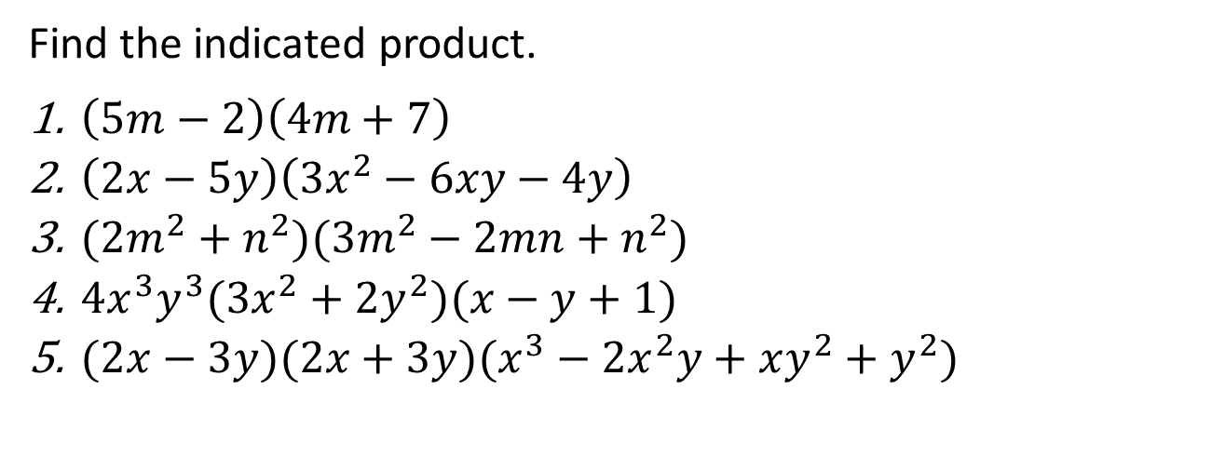
MULTIPLICATION OF POLYNOMIALS
Find the indicated product.
$\left(5m−2\right)\left(4m+7\right)$
$\left(2x−5y\right)\left(3x^{2}−6xy−4y\right)$
$(2m^{2}+n^{2})(3m^{2}−2mn+n^{2})$
$4x^{3}y^{3}(3x^{2}+2y^{2})(x−y+1)$
$(2x−3y)(2x+3y)(x^{3}−2x^{2}y+xy^{2}+y^{2})$

Slide 43
DIVISION OF POLYNOMIALS
To divide a polynomial by a monomial, divide each term of the polynomial by the monomial by applying the rules for signed numbers and applying the laws of exponent.
To divide a polynomial by another polynomial , arrange each polynomial in alphabetical and descending order of one variable and use the long division process.
Another way of dividing a polynomial P(x) by a binomial of the form ax – r is through the use of synthetic division which is very useful when dividing polynomial of more than the second degree.
We can also use synthetic division when dividing a polynomial by another polynomial other than binomial. We call this as extended synthetic division.

Slide 44
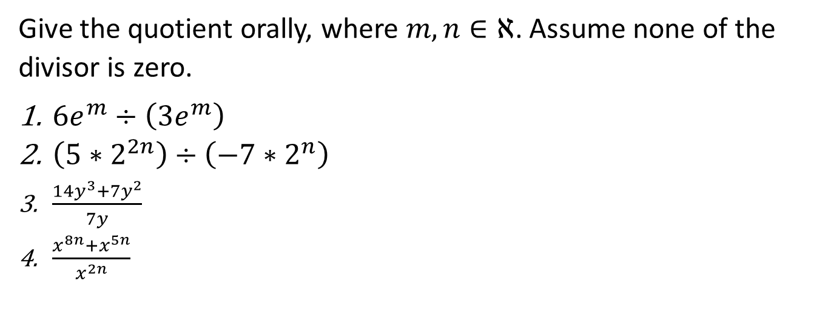
DIVISION OF POLYNOMIALS
Give the quotient orally, where $m, n∈ℵ$. Assume none of the divisor is zero.
$6e^{m}÷\left(3e^{m}\right)$
$\left(5∗2^{2n}\right)÷\left(−7∗2^{n}\right)$
$\frac{14y^{3}+7y^{2}}{7y}$
$\frac{x^{8n}+x^{5n}}{x^{2n}}$

Slide 45
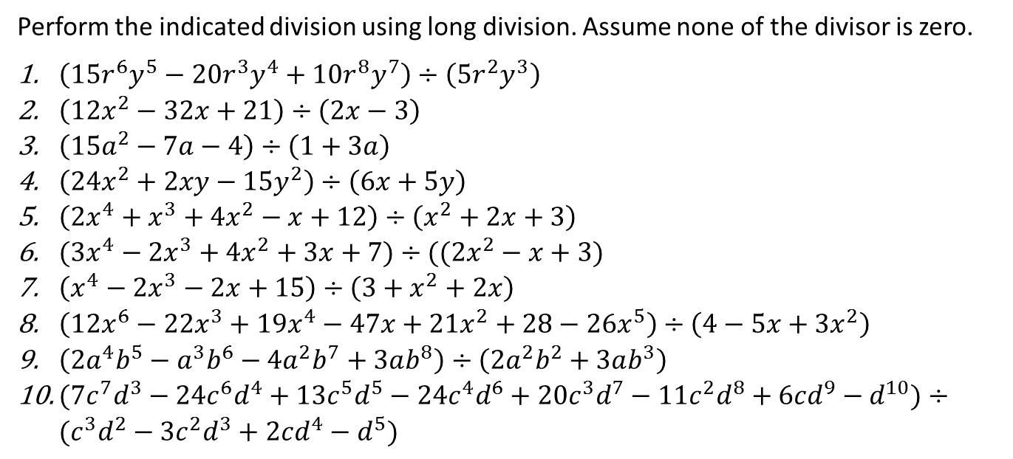
DIVISION OF POLYNOMIALS
Perform the indicated division using long division. Assume none of the divisor is zero.
$\left(15r^{6}y^{5}−20r^{3}y^{4}+10r^{8}y^{7}\right)÷\left(5r^{2}y^{3}\right)$
$\left(12x^{2}−32x+21\right)÷\left(2x−3\right)$
$\left(15a^{2}−7a−4\right)÷\left(1+3a\right)$
$\left(24x^{2}+2xy−15y^{2}\right)÷\left(6x+5y\right)$
$\left(2x^{4}+x^{3}+4x^{2}−x+12\right)÷\left(x^{2}+2x+3\right)$
$(3x^{4}−2x^{3}+4x^{2}+3x+7)÷((2x^{2}−x+3)$
$\left(x^{4}−2x^{3}−2x+15\right)÷\left(3+x^{2}+2x\right)$
$\left(12x^{6}−22x^{3}+19x^{4}−47x+21x^{2}+28−26x^{5}\right)÷\left(4−5x+3x^{2}\right)$
$\left(2a^{4}b^{5}−a^{3}b^{6}−4a^{2}b^{7}+3ab^{8}\right)÷\left(2a^{2}b^{2}+3ab^{3}\right)$
$(7c^{7}d^{3}−24c^{6}d^{4}+13c^{5}d^{5}−24c^{4}d^{6}+20c^{3}d^{7}−11c^{2}d^{8}+6cd^{9}−d^{10})÷(c^{3}d^{2}−3c^{2}d^{3}+2cd^{4}−d^{5})$

Slide 46
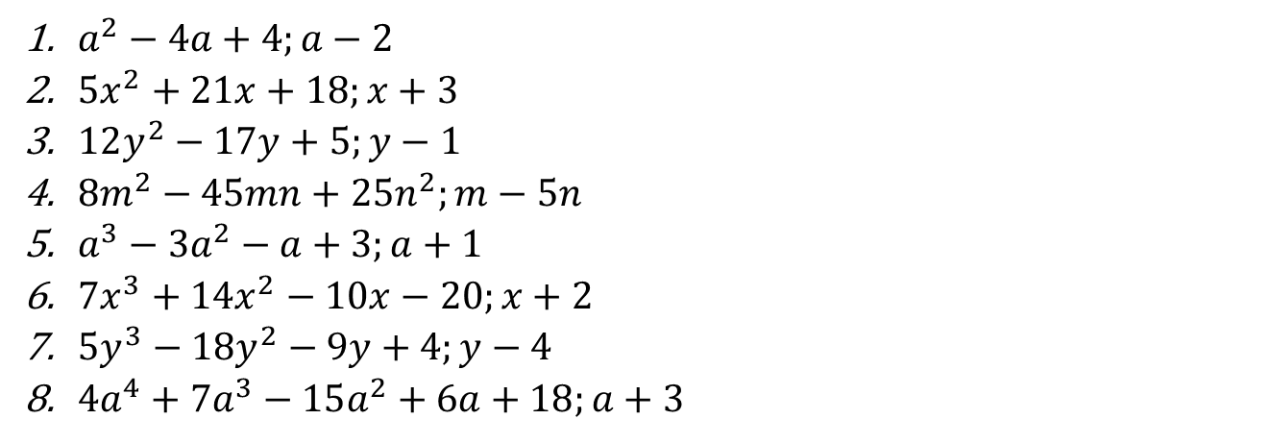
Divide the first polynomial by the second polynomial synthetically.
Assume none of the divisor is zero.
$a^{2}−4a+4;a−2$
$5x^{2}+21x+18;x+3$
$12y^{2}−17y+5;y−1$
$8m^{2}−45mn+25n^{2};m−5n$
$a^{3}−3a^{2}−a+3;a+1$
$7x^{3}+14x^{2}−10x−20;x+2$
$5y^{3}−18y^{2}−9y+4;y−4$
$4a^{4}+7a^{3}−15a^{2}+6a+18;a+3$

Slide 47
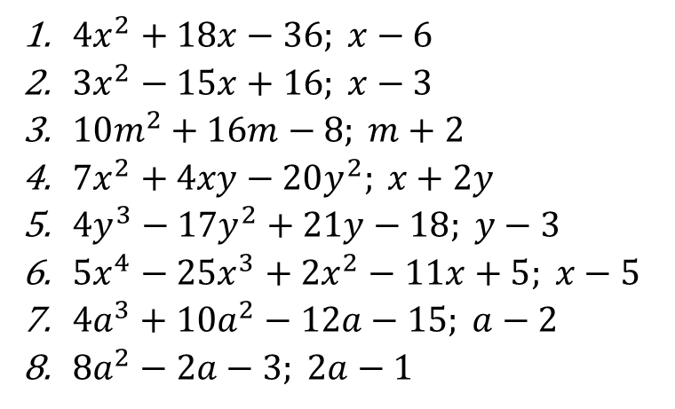
Divide the first polynomial by the second polynomial synthetically.
Assume none of the divisor is zero.
$4x^{2}+18x−36; x−6$
$3x^{2}−15x+16; x−3$
$10m^{2}+16m−8; m+2$
$7x^{2}+4xy−20y^{2}; x+2y$
$4y^{3}−17y^{2}+21y−18; y−3$
$5x^{4}−25x^{3}+2x^{2}−11x+5; x−5$
$4a^{3}+10a^{2}−12a−15; a−2$
$8a^{2}−2a−3; 2a−1$

Slide 48
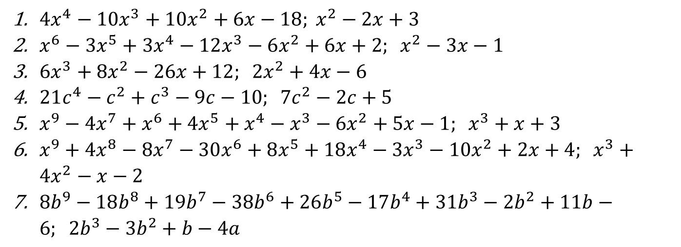
Divide the first polynomial by the second polynomial using extended synthetic division
$4x^{4}−10x^{3}+10x^{2}+6x−18; x^{2}−2x+3$
$x^{6}−3x^{5}+3x^{4}−12x^{3}−6x^{2}+6x+2; x^{2}−3x−1$
$6x^{3}+8x^{2}−26x+12; 2x^{2}+4x−6$
$21c^{4}−c^{2}+c^{3}−9c−10; 7c^{2}−2c+5$
$x^{9}−4x^{7}+x^{6}+4x^{5}+x^{4}−x^{3}−6x^{2}+5x−1; x^{3}+x+3$
$x^{9}+4x^{8}−8x^{7}−30x^{6}+8x^{5}+18x^{4}−3x^{3}−10x^{2}+2x+4; x^{3}+4x^{2}−x−2$
$8b^{9}−18b^{8}+19b^{7}−38b^{6}+26b^{5}−17b^{4}+31b^{3}−2b^{2}+11b−6; 2b^{3}−3b^{2}+b−4a$

Slide 49
SPECIAL PRODUCTS

Slide 50
SPECIAL PRODUCTS
Certain types of products occur so frequently that they deserve our special attention. Such products are called special products and they should be learned and memorized in order to save time in multiplication.

Slide 51
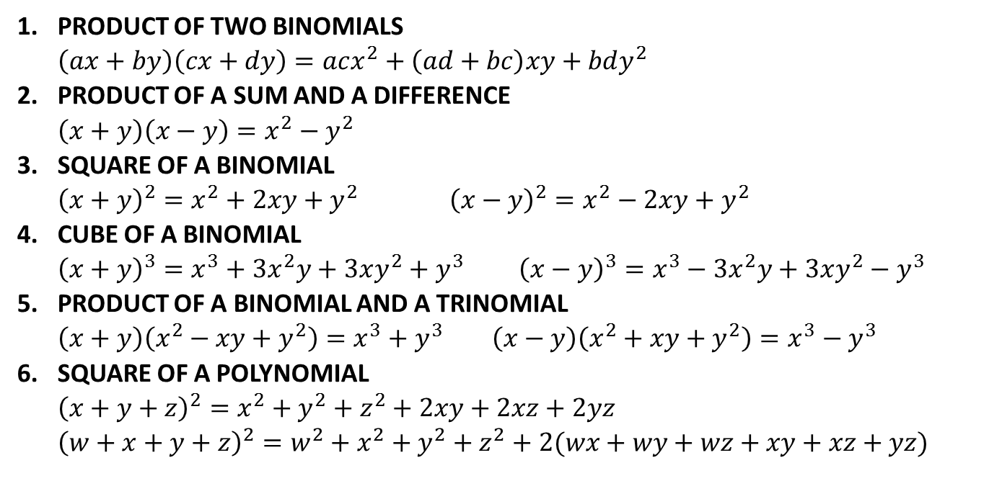
SPECIAL PRODUCT FORMULAS
PRODUCT OF TWO BINOMIALS $\left(ax+by\right)\left(cx+dy\right)=acx^{2}+\left(ad+bc\right)xy+bdy^{2}$
PRODUCT OF A SUM AND A DIFFERENCE $\left(x+y\right)\left(x−y\right)=x^{2}−y^{2}$
SQUARE OF A BINOMIAL ${\left(x+y\right)}^{2}=x^{2}+2xy+y^{2} {\left(x−y\right)}^{2}=x^{2}−2xy+y^{2}$
CUBE OF A BINOMIAL ${\left(x+y\right)}^{3}=x^{3}+3x^{2}y+3xy^{2}+y^{3} {\left(x−y\right)}^{3}=x^{3}−3x^{2}y+3xy^{2}−y^{3}$
PRODUCT OF A BINOMIAL AND A TRINOMIAL $\left(x+y\right)\left(x^{2}−xy+y^{2}\right)=x^{3}+y^{3} \left(x−y\right)\left(x^{2}+xy+y^{2}\right)=x^{3}−y^{3}$
SQUARE OF A POLYNOMIAL ${\left(x+y+z\right)}^{2}=x^{2}+y^{2}+z^{2}+2xy+2xz+2yz$ ${\left(w+x+y+z\right)}^{2}=w^{2}+x^{2}+y^{2}+z^{2}+2(wx+wy+wz+xy+xz+yz)$

Slide 52
PRODUCT OF TWO BINOMIALS
If the terms of the binomials (a + b) and (c + d) are labeled as shown below, then the product of the two binomials can be computed mentally by the FOIL method.

Slide 53
EXAMPLE
PRODUCT OF TWO BINOMIALS
In the following illustration, we find the product of (7x – 2) and (5x + 4) by the FOIL method.
(7x – 2)(5x + 4) = (7x)(5x) + (7x)(4) + (–2)(5x) + (–2)(4)
= 35x² + 28x – 10x – 8
= 35x² + 18x – 8

Slide 54
EXAMPLE
PRODUCT OF SUM AND DIFFERENCE OF A BINOMIAL
(x+ y)(x – y) = x² – y²

Slide 55
EXAMPLE
SQUARE OF A BINOMIAL
(x + y)² = x² + 2xy + y²
(x – y)² = x² – 2xy + y²

Slide 56
EXAMPLE
CUBE OF A BINOMIAL
(x + y)³ = x³ + 3x²y+ 3xy² + y³
(x – y)³ = x³ – 3x²y + 3xy² – y³

Slide 57
EXAMPLE
PRODUCT A BINOMIAL AND A TRINOMIAL
(x + y)(x²-xy+y²) = x³ + y³
(x – y)(x²+xy+y²) = x³ – y³

Slide 58
EXAMPLE
SQUARE OF A POLYNOMIAL
(x + y + z)² = x² + y² +z² + 2xy + 2xz + 2yz
(w+ x + y + z)² = w² + x² + y² +z² + 2(wx + wy + wz + xy + xz + yz)

Slide 59
FACTORING POLYNOMIALS

Slide 60
FACTORING POLYNOMIALS
Writing a polynomial as a product of polynomials is called
factoring. Factoring is an important procedure that is often
used to simplify fractional expressions and to solve
equations.
In this section, we consider only the factorization of polynomials that have integer coefficients. Also, we are concerned only with factoring over the integers.
That is, we search only for polynomial factors that have integer coefficients.

Slide 61
GREATEST COMMON FACTOR
The first step in the factorization of any polynomial is to use
the distributive property to factor out the greatest common
factor (GCF) of the terms of the polynomial.
Given two or more exponential expressions with the same prime number base or the same variable base, the GCF is the exponential expression with the smallest exponent.
2³ is the GCF of 2³, 2⁵, and 2⁸ and a is the GCF of a⁴ and a
EXAMPLE

Slide 62
GREATEST COMMON FACTOR
The GCF of two or more monomials is the product of the
GCFs of all the common bases.
For example, to find the GCF of 27a³b⁴ and 18b³c, factor the coefficients into prime factors and then write each common base with its smallest exponent.
27a³b⁴ = 3³  a³  b⁴ 18b³c = 2  3²  b³  c
The only common bases are 3 and b. The product of these common bases with their smallest exponents is 3²b³. The GCF of 27a³b⁴ and 18b³c is 9b³.

Slide 63
GREATEST COMMON FACTOR
The expressions 3x(2x + 5) and 4(2x + 5) have a common
binomial factor, which is 2x + 5. Thus the GCF of 3x(2x + 5)
and 4(2x + 5) is 2x + 5.

Slide 64
GREATEST COMMON FACTOR
FACTOR OUT THE GREATEST COMMON FACTOR
Factor out the GCF.
a. 12x³y⁴ – 24x²y⁵ + 18xy⁶
b. (6x – 5)(4x + 3) – (4x + 3)(3x – 7)
Solution:
a. 12x³y⁴ – 24x²y⁵ + 18xy⁶
= (6xy⁴)2x² – (6xy⁴)4xy + (6xy⁴)3y²
= 6xy⁴(2x² – 4xy + 3y²)
The GCF is 6xy⁴.
Factor out the GCF.

Slide 65
cont’d
b. (6x – 5)(4x + 3) – (4x + 3)(3x – 7)
= (4x + 3)[(6x – 5) – (3x – 7)]
= (4x + 3)(3x + 2)
The common binomial factor is 4x + 3.

Slide 66
FACTORING TRINOMIALS
Some trinomials of the form x² + bx + c can be factored by a trial procedure. This method makes use of the FOIL method in reverse.
For example, consider the following products.
(x + 3)(x + 5) = x² + 5x + 3x + (3)(5) = x² + 8x + 15
(x – 2)(x – 7) = x² – 7x – 2x + (–2)(–7) = x² – 9x + 14
(x + 4)(x – 9) = x² – 9x + 4x + (4)(–9) = x² – 5x – 36
The coefficient of x is the sum of the constant terms of the binomials.
The constant term of the trinomial is the product of the constant terms of the binomials.

Slide 67
FACTORING TRINOMIALS
Points to Remember to Factor x² + bx + c
1. The constant term c of the trinomial is the product of the constant terms of the binomials.
2. The coefficient b in the trinomial is the sum of the constant terms of the binomials.
3. If the constant term c of the trinomial is positive, the constant terms of the binomials have the same sign as the coefficient b in the trinomial.
4. If the constant term c of the trinomial is negative, the constant terms of the binomials have opposite signs.

Slide 68
FACTORING TRINOMIALS
EXAMPLE
Factor.
a. x² + 7x – 18 b. x² + 7xy + 10y²
Solution:
a. Find two integers whose product is –18 and whose sum is 7.
The integers are –2 and 9: –2(9) = –18, –2 + 9 = 7.
x² + 7x – 18 = (x – 2)(x + 9)

Slide 69
FACTORING TRINOMIALS
cont’d
b. Find two integers whose product is 10 and whose sum is 7.
The integers are 2 and 5: 2(5) = 10, 2 + 5 = 7.
x² + 7xy + 10y² = (x + 2y)(x + 5y)

Slide 70
FACTORING TRINOMIALS
Sometimes it is impossible to factor a polynomial into the product of two polynomials having integer coefficients. Such polynomials are said to be non factorable over the integers.
For example, x² + 3x + 7 is non factorable over the integers because there are no integers whose product is 7 and whose sum or difference is 3.
The trial method sometimes can be used to factor trinomials of the form ax² + bx + c, which do not have a leading coefficient of 1.

Slide 71
FACTORING TRINOMIALS
We use the factors of a and c to form trial binomial factors. Factoring trinomials of this type may require testing many factors. To reduce the number of trial factors, make use of the following points.
Points to Remember to Factor ax² + bx + c, a > 0
1. If the constant term of the trinomial is positive, the constant terms of the binomials have the same sign as the coefficient b in the trinomial.
2. If the constant term of the trinomial is negative, the constant terms of the binomials have opposite signs.

Slide 72
FACTORING TRINOMIALS
3. If the terms of the trinomial do not have a common factor, then neither binomial will have a common factor.
If you have difficulty factoring a trinomial, you may wish to use the following theorem. It will indicate whether the trinomial is factorable over the integers.
Factorization Theorem
The trinomial ax² + bx + c, with integer coefficients a, b, and c, can be factored as the product of two binomials with integer coefficients if and only if b² – 4ac is a perfect square.

Slide 73
FACTORING TRINOMIALS
The product of a term and itself is called a perfect square.
The exponents on variables of perfect squares are always
even numbers.
The square root of a perfect square is one of the two equal factors of the perfect square.
To find the square root of a perfect square variable term, divide the exponent by 2.

Slide 74
SPECIAL FACTORING
For the examples in Table below, assume that the variables represent positive numbers.
The factors of the difference of two perfect squares are the sum and difference of the square roots of the perfect squares.
Perfect Squares and Square Roots

Slide 75
SPECIAL FACTORING
Factors of the Difference of Two Perfect Squares
a² – b² = (a + b)(a – b)
The difference of two perfect squares always factors over the integers. However, the sum of squares does not factor over the integers.
For instance, a² + b² does not factor over the integers. As another example, x² + 4 is the sum of squares and does not factor over the integers.
There are no integers whose product is 4 and whose sum is 0.

Slide 76
SPECIAL FACTORING
Factors of the Difference of Two Perfect Squares
a² – b² = (a + b)(a – b)
The difference of two perfect squares always factors over the integers. However, the sum of squares does not factor over the integers.
For instance, a² + b² does not factor over the integers. As another example, x² + 4 is the sum of squares and does not factor over the integers.
There are no integers whose product is 4 and whose sum is 0.

Slide 77
EXAMPLE
Factor.
a. 49x² – 144 b. a⁴ – 81
Solution:
a. 49x² – 144 = (7x)² – 12²
= (7x + 12)(7x – 12)
b. a⁴ – 81 = (a²)² – (9)²
= (a² + 9)(a² – 9)
Write as the difference of squares.
The binomial factors are the sum and the difference of the square roots of the squares.
Write as the difference of squares.
The binomial factors are the sum and the difference of the square roots of the squares.

Slide 78
cont’d
= (a + 3)(a – 3)(a² + 9)
a² – 9 is the difference of squares. Factor as (a + 3)(a – 3). The sum of squares,
a² + 9, does not factor over the integers.

Slide 79
SPECIAL FACTORING
A perfect-square trinomial is a trinomial that is the square of a binomial. For example, x² + 6x + 9 is a perfect-square trinomial because
(x + 3)² = x² + 6x + 9
Every perfect-square trinomial can be factored by the trial method, but it generally is faster to factor perfect-square trinomials by using the following factoring formulas.
Factors of a Perfect-Square Trinomial
a² + 2ab + b² = (a + b)²
a² – 2ab + b² = (a – b)²

Slide 80
SPECIAL FACTORING
The product of the same three terms is called a perfect cube. The exponents on variables of perfect cubes are always divisible by 3.
The cube root of a perfect cube is one of the three equal factors of the perfect cube. To find the cube root of a perfect cube variable term, divide the exponent by 3. See Table below
Perfect Cubes and Cube Roots

Slide 81
SPECIAL FACTORING
The following factoring formulas are used to factor the sum or difference of two perfect cubes.
Factors of the Sum or Difference of Two Perfect Cubes
a³ + b³ = (a + b)(a² – ab + b²)
a³ – b³ = (a – b)(a² + ab + b²)
Certain trinomials can be expressed as quadratic trinomials by making suitable variable substitutions. A trinomial is quadratic in form if it can be written as
au² + bu + c

Slide 82
SPECIAL FACTORING
If we let x² = u, the trinomial x⁴ + 5x² + 6 can be written as
x⁴ + 5x² + 6 = (x²)² + 5(x²) + 6
= u² + 5u + 6
The trinomial is quadratic in form.
If we let xy = u, the trinomial 2x²y² + 3xy – 9 can be written as
2x²y² + 3xy – 9 = 2(xy)² + 3(xy) – 9
= 2u² + 3u – 9
The trinomial is quadratic in form.

Slide 83
SPECIAL FACTORING
When a trinomial that is quadratic in form is factored, the variable part of the first term in each binomial factor will be u.
For example, because x⁴ + 5x² + 6 is quadratic in form when x² = u, the first term in each binomial factor will be x².
x⁴ + 5x² + 6 = (x²)² + 5(x²) + 6
= (x² + 2)(x² + 3)
The trinomial x²y² – 2xy – 15 is quadratic in form when xy = u. The first term in each binomial factor will be xy.
x²y² – 2xy – 15 = (xy)² – 2(xy) – 15
= (xy + 3)(xy – 5)

Slide 84
FACTOR BY GROUPING
Some polynomials can be factored by grouping. Pairs of terms that have a common factor are first grouped together.
The process makes repeated use of the distributive property, as shown in the following factorization of 6y³ – 21y² – 4y + 14.
6y³ – 21y² – 4y + 14
= (6y³ – 21y²) – (4y – 14)
= 3y²(2y – 7) – 2(2y – 7)
Group the first two terms and the last two terms.
Factor out the GCF from each of the groups.

Slide 85
= (2y – 7)(3y² – 2)
When you factor by grouping, some experimentation may be necessary to find a grouping that fits the form of one of the special factoring formulas.
Factor out the common binomial factor.

Slide 86
EXAMPLE
Factor by grouping.
a. a² + 10ab + 25b² – c²
b. p² + p – q – q²
Solution:
a. a² + 10ab + 25b² – c²
= (a² + 10ab + 25b²) – c²
= (a + 5b)² – c²
= [(a + 5b) + c][(a + 5b) – c]
= (a + 5b + c)(a + 5b – c)
Group the terms of the perfect square trinomial.
Factor the trinomial.
Factor the difference of squares.
Simplify.

Slide 87
cont’d
b. p² + p – q – q²
= p² – q² + p – q
= (p² – q²) + (p – q)
= (p + q)(p – q) + (p – q)
= (p – q)(p + q + 1)
Rearrange the terms.
Regroup.
Factor the difference of squares.
Factor out the common factor (p – q).

Slide 88
GENERAL FACTORING
A general factoring strategy for polynomials is shown below.
General Factoring Strategy
1. Factor out the GCF of all terms.
2. Try to factor a binomial as
a. the difference of two squares
b. the sum or difference of two cubes

Slide 89
3. Try to factor a trinomial
a. as a perfect–square trinomial
b. using the trial method
4. Try to factor a polynomial with more than three terms by grouping.
5. After each factorization, examine the new factors to see whether they can be factored.

Slide 90
FACTOR USING THE GENERAL FACTORING STRATEGY
Factor: 2vx⁶ + 14vx³ – 16v
Solution:
2vx⁶ + 14vx³ – 16v
= 2v(x⁶ + 7x³ – 8)
= 2v(u² + 7u – 8)
= 2v(u + 8)(u – 1)
The GCF is 2v.
x⁶ + 7x³ – 8 is quadratic in form.
Let u = x³. Then u² = x⁶.
Factor.

Slide 91
cont’d
= 2v(x³ + 8)(x³ – 1)
= 2v(x + 2)(x² – 2x + 4)(x – 1)(x² + x + 1)
Replace u with x³. x³ + 8 is the sum of
cubes. x³ – 1 is the difference of cubes.
Factor the sum and difference of cubes.

Slide 92
FACTOR ING BY ADDING AND SUBTRACTING A SUITABLE TERM
Recall that in a perfect square trinomial the middle term should be twice the product of the square roots of the first and last terms. Adding and subtracting suitable terms can sometimes be used whenever the polynomial is not a perfect square trinomial .
EXAMPLE
Factor each of the following completely.

Slide 93
FACTOR ING BY ADDING AND SUBTRACTING A SUITABLE TERM
Solution:

Slide 94
FACTOR BY SYNTHETIC DIVISION
Polynomials in one variable of degree higher than two can be factored by means of synthetic division. The terms are arranged in descending power of the variable and then apply the steps in synthetic division.
EXAMPLE
Factor each of the following polynomials.

Slide 95
FACTOR ING BY BINOMIALS OF THE FORM
Binomials that can be reduced to either the sum or difference of two cubes or two squares can be factored easily. However if the binomials contain odd number exponents which cannot be reduced to third power, it is convenient to use the pattern shown below:
EXAMPLE
Factor each of the following polynomials completely.

Slide 96
EXERCISES

